Slide 1
Ridge Regression

Slide 2
Prerequisites
Linear Regression
Gradient Descent

Slide 3
Contents
Introduction to Ridge Regression
Problem with Linear Regression
How ridge regression solves the problem with Linear Regression
Working of Ridge Regression
Pros and Cons
Applications

Slide 4
Introduction to Ridge Regression
Ridge Regression also called as L2 regularisation is a regularisation technique that helps to overcome some of the problems caused by Linear regression.
Linear regression sometimes causes the model to overfit. Ridge regression helps us to minimising these coefficients and reduce the overfitting.

Slide 5
Problem with Linear Regression
Linear regression model tries to fit the dataset in such a way that it minimizes squared errors.
This model treats all the features equally and sometimes the features can be highly correlated which causes the model to overfit.
The model is said to be over fitted when the model has low bias and high variance.
This is where ridge regression comes into rescue where an additional penalty is added to control the coefficients so that the model doesn’t over-fit.

Slide 6
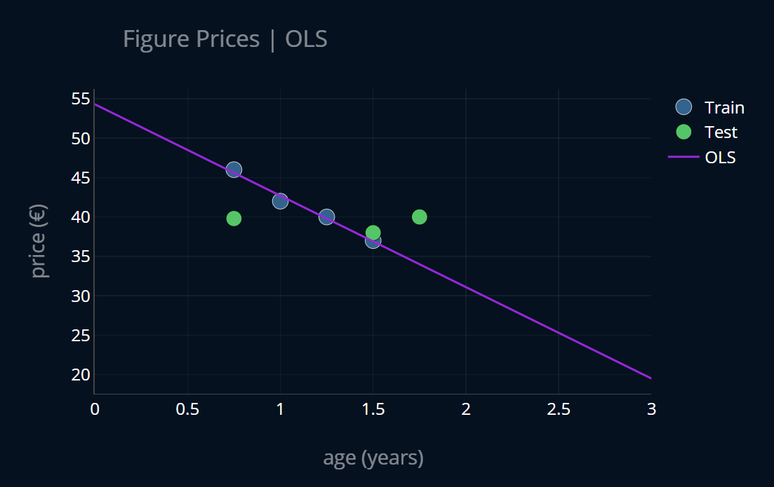
Problem with Linear Regression
Example :-
Here we are considering an example for predicting the price of the house based on how old it is (i.e years).

Slide 7
How Ridge Regression Solves This Problem
Ridge regression fixes this problem of overfitting by adding a ridge penalty (i.e Lambda) and adjusting its value.
As ridge penalty( lambda value) increases the coefficients start moving more and more towards zero and the line gets less steeper.
But when the lambda value increases too much the models starts to underfit.
How to pick a lambda value:
The lambda value can be chosen by running a cross validation technique.The value with less variance is chosen.

Slide 8
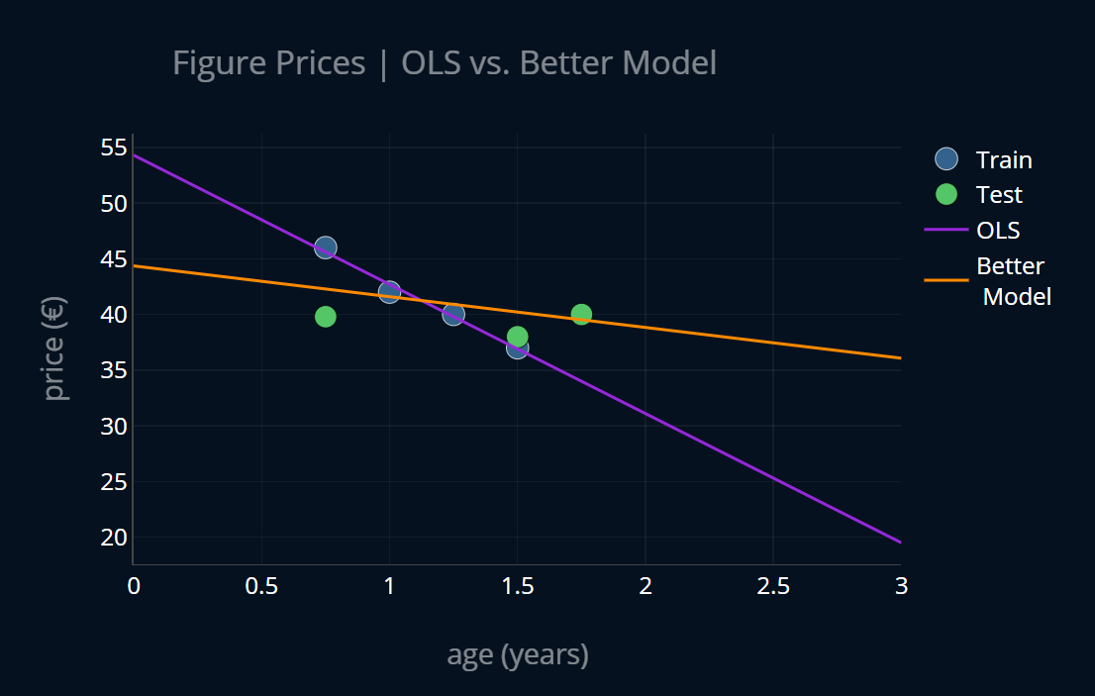
How Ridge Regression Solves This Problem
Example :-
Here we are considering an example for predicting the price of the house based on how old it is (i.e years).

Slide 9
Linear Regression Vs Ridge Regression
 | MSE (TRAIN) | MSE (TEST) | R.DIFF
OLS | 0.175 | 23.62 | 13397.14%
Imaginary model | 6.28 | 3.77 | 50.2%

Slide 10
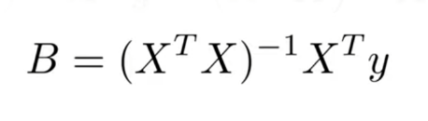
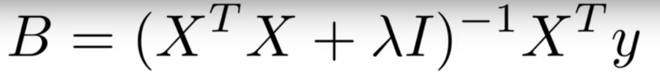
Working of Ridge Regression
Formula for Linear Regression algorithm
Formula for Ridge Regression algorithm
Where I is the identity matrix
Lambda is ridge regression penalty

Slide 11
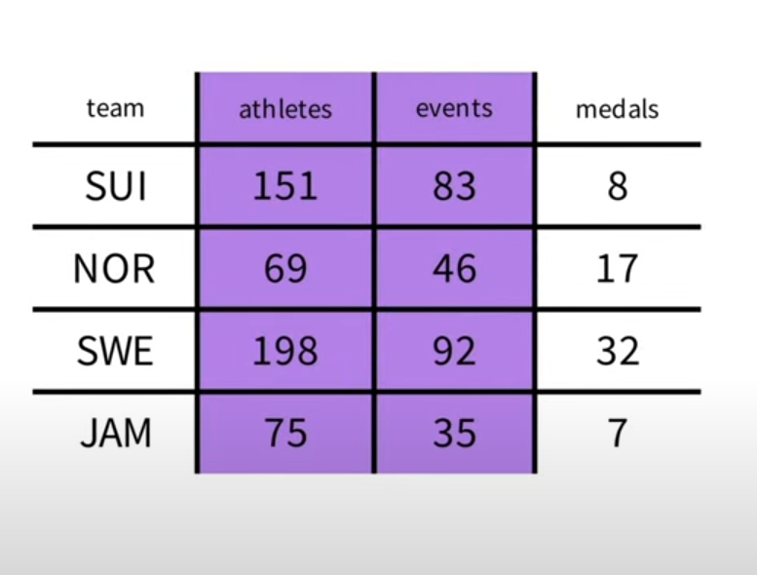
Working of Ridge Regression
Example

Slide 12
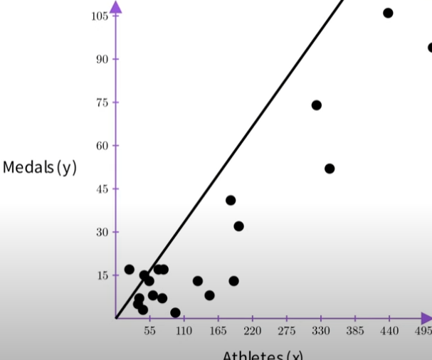
Working of Ridge Regression
When we try to fit the data it fits perfectly for training set
The coefficients for the dataset is as follows
B0 = 0.3 , B1 = - 0.18

Slide 13
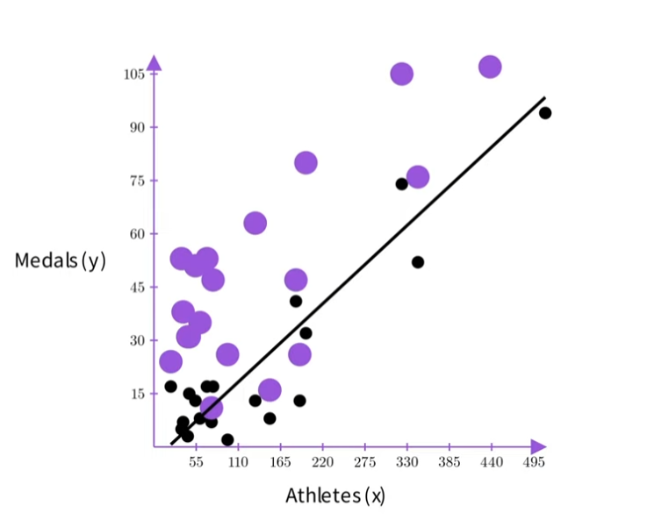
Working of Ridge Regression
When we test it out for future data points our model doesn’t do well as its accustomed to only what’s present in our training data so it looks something like this.
So we try to vary the coefficients using the ridge penalty (i.e Lambda)

Slide 14
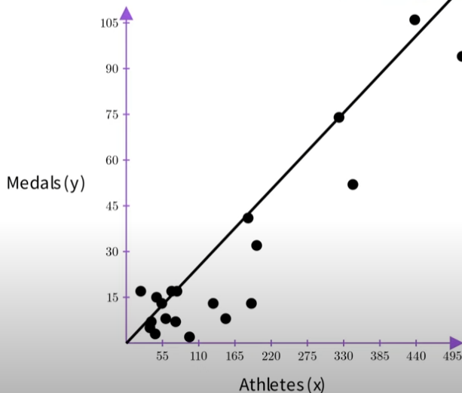
Working of Ridge Regression
With Lambda set for 40
The coefficients for the dataset is as follows
B0 = 0.23 , B1 = 0.0
Similarly as lambda values increase the coefficients tend to move towards zero
But increasing the lambda value to much might lead to under fitting.

Slide 15
Pros and cons
Pros:
Reduces Overfitting
Enables matrix inversion
Cons:
Like any other algorithms ridge regression also has some limitations
Overfitting can still occur if regularization term is not set properly
Limited to linear models
calculation of the ridge regression coefficients can be computationally expensive, especially when the number of features is large

Slide 16
Applications
Predicting housing prices based on various features such as location, square footage, and number of bedrooms
Analyzing the effectiveness of different marketing campaigns by comparing customer behavior data.
Predicting loan default risk based on the borrower's credit score, income, and other factors.
Analyzing the impact of different factors on student performance, such as study hours, family income, and school quality.

Slide 17
Thank you

